Slide 1
NORMALIZATION
Normalization is a technique to remove or reduce redundancy from a table
StudentID | StdName | Age
01 | Asad | 20
02 | Saleem | 25
01 | Asad | 20
Example No.1
Row level Duplication
By setting Primary key ,duplication can be reduced
https://www.youtube.com/watch?v=5GDTIUVlHB8

Slide 2
Example II
StdID | Sname | CourseID | CourseName | FacID | FacName | Salary
01 | Asad | C1 | DBMS | F1 | Mr.A | 30000
02 | Saleem | C2 | Java | F2 | Mr.B | 40000
03 | Khalid | C1 | DBMS | F1 | Mr.A | 30000
04 | Rasheed | C1 | DBMS | F1 | Mr.A | 30000
Column Level Duplication
Issues :
(i) Insertion Anomaly
(ii) Deletion Anomaly
(iii) Updation Anomaly
Solution :
Separate tables such as
(i) Student
(ii) Course
(iii) Faculty

Slide 3
1st Normal Formal
As per EF codd ,table should not contains multivalued attributes
Roll No | Name | Course
1 | Ahmed | C/C++
2 | Saleem | Java
3 | Asad | C/DBMS
Solution
Roll No | Name | Course
1 | Ahmed | C
1 | Ahmed | C++
2 | Saleem | Java
3 | Asad | C
3 | Asad | DBMS

Slide 4
1st Normal Formal Cont…
Solution 02
Student
Roll No | Name | Course1 | Course 2
1 | Ahmed | C | C++
2 | Saleem | Java | Null
3 | Asad | C | DBMS
Solution 03
Student
Course
Roll No | Name
1 | Ahmed
2 | Saleem
3 | Asad
Roll No | Course
1 | C
1 | C++
2 | Java
3 | C
3 | DBMS
https://www.youtube.com/watch?v=NlgZy30Dv9A

Slide 5
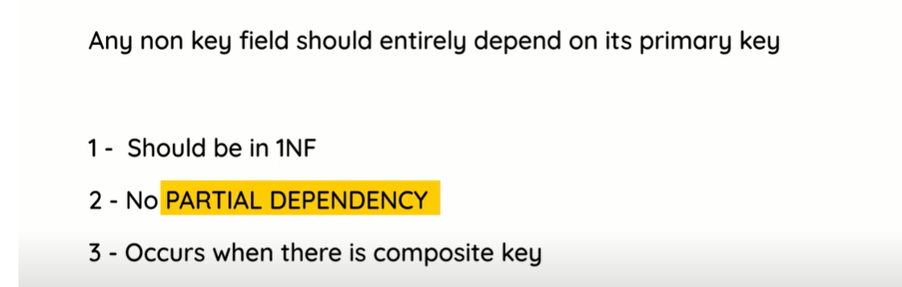
https://www.youtube.com/watch?v=xPzgK6sOCfg

Slide 6
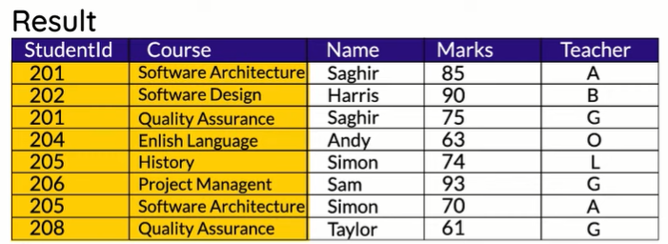





Slide 7
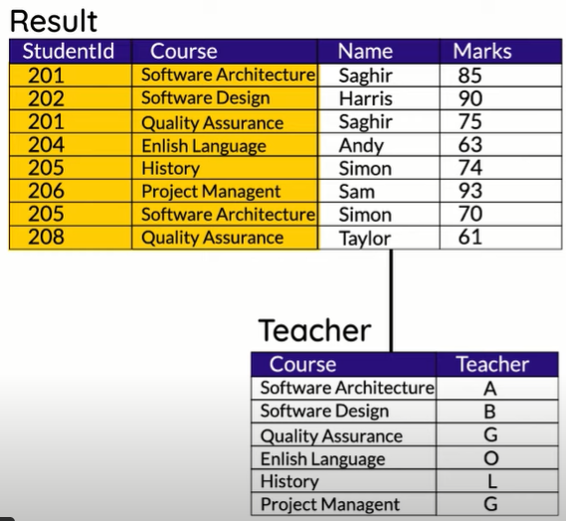
Solution

Slide 8
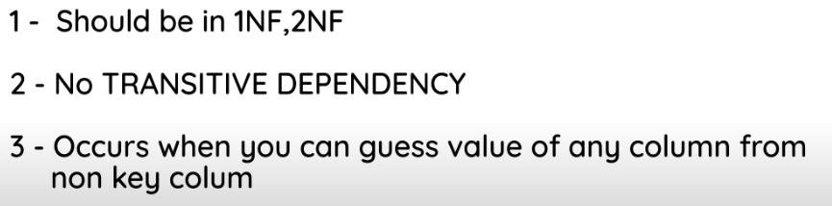

Slide 9
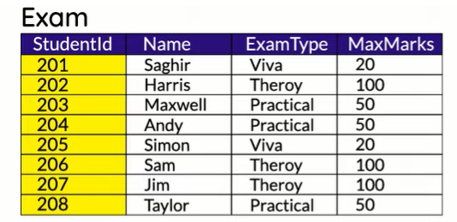





Slide 10
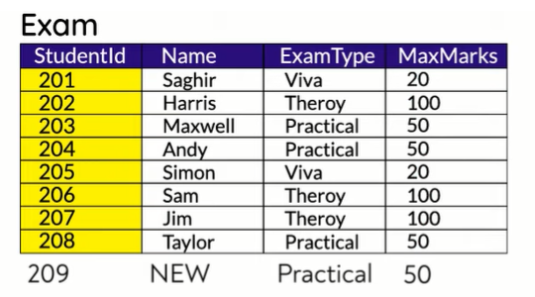
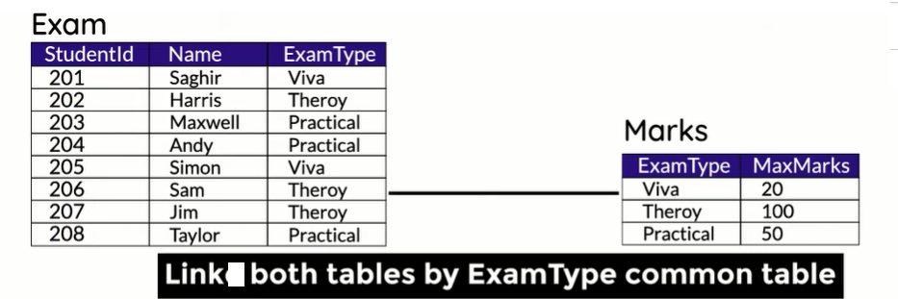
Solution

Slide 11
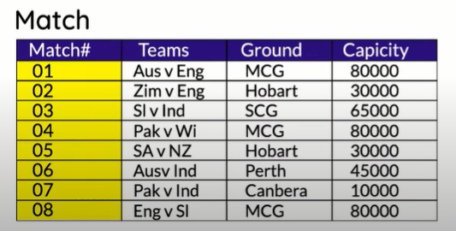


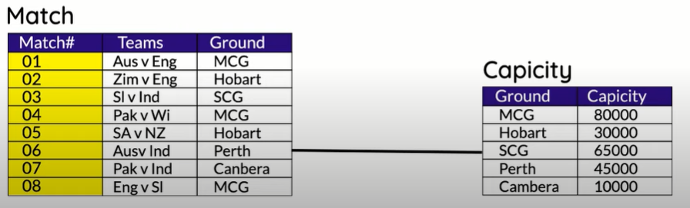
3rd NF EXAMPLE NO.02
Solution

Slide 12
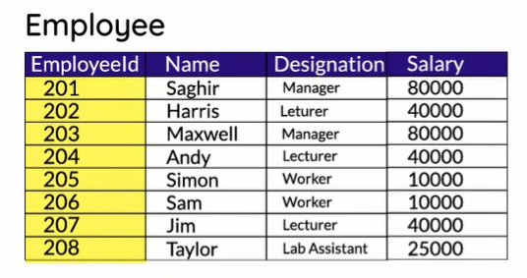


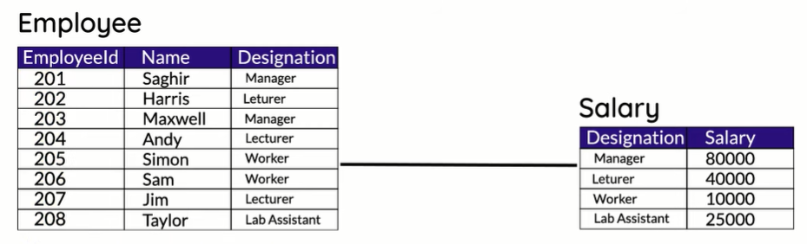
3rd NF EXAMPLE NO.03
Solution

Slide 13
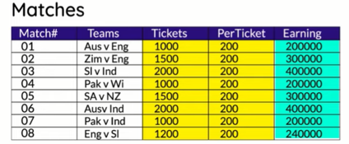
3rd NF EXAMPLE NO.04
Earning is depending on number of tickets sold

